Slide 1

4
Vector geometry

Slide 2













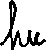




Slide 3
Chapter Outline
4.1. Vectors and Lines
4.2. Projections and Planes
4.3. More on the Cross Product
4.4. Linear Operations on ○³
4.5. An application to Computer Graphics

Slide 4
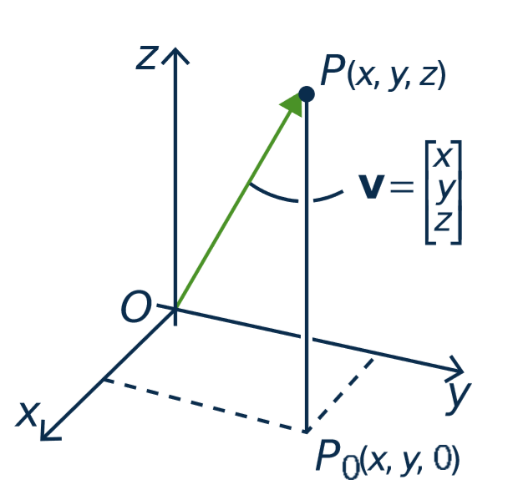

4.1. Vectors and Lines
point P(x, y, z)
Vectors in ○³
The terms vector and point
are interchangeable.
vector v

Slide 5












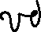




















Slide 6
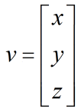
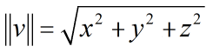
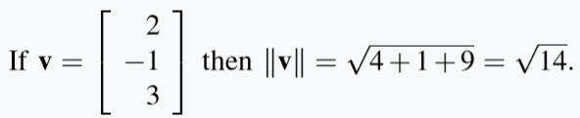









Vectors in ○³
Length.
If then
Ex.

Slide 7

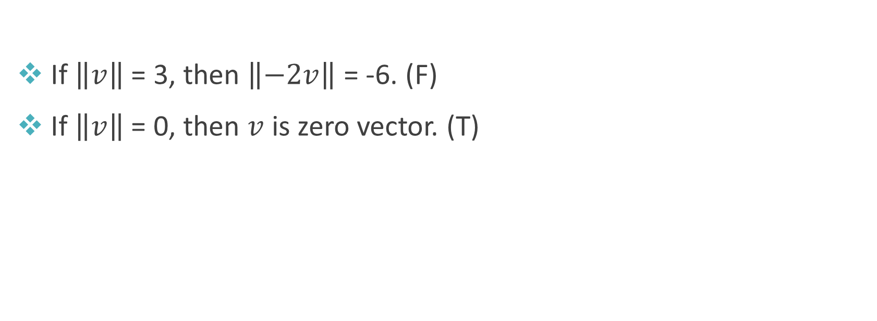


True or false?
If $\left\|v\right\|$ = 3, then $\left\|−2v\right\|$ = -6. (F)
If $\left\|v\right\|$ = 0, then $v$ is zero vector. (T)
-2v
v

Slide 8
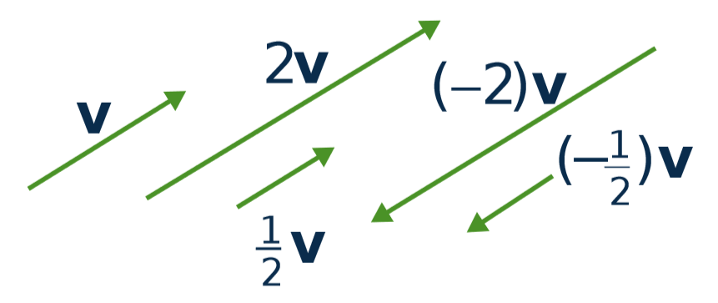
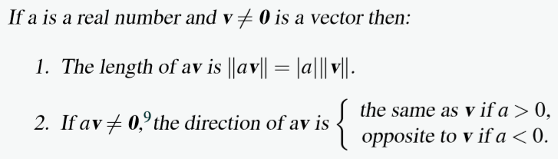













Scalar Multiple Law

Slide 9



Equality
Let v ≠ 0 and w ≠ 0 be vectors in R³.
Then v = w if and only if v and w have the same direction and the same length.
➔ The same geometric vector can be positioned anywhere in space.
•
•
v
w
•
•

Slide 10





Parallel vectors
Two nonzero vectors are called parallel if they have the same or opposite direction.
v and w are parallel ⇔ v = kw for some scalar k
v
-2v

Slide 11











The Parallelogram Law
v
v + w ⬅ first v then w
w
v + w = w + v

Slide 12
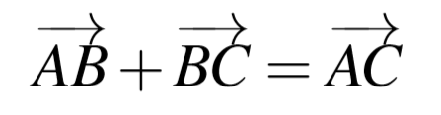



Tip-to-tail rule
B
C
A

Slide 13
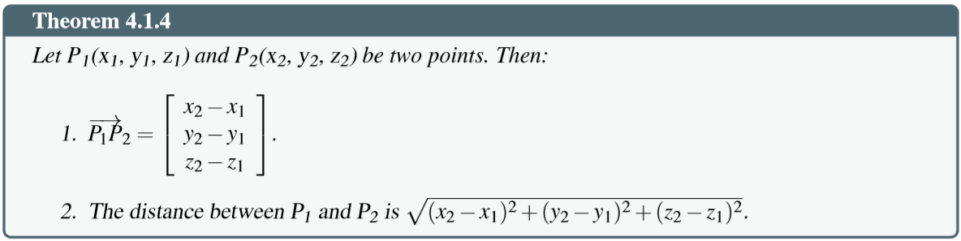
Distance between two points

Slide 14
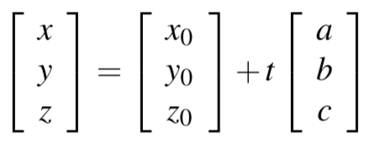


Lines in Space
Given the point P₀ (with vector p₀) and the direction vector d ≠ 0.
Then line parallel to d through the point P₀ is given by:
p = p₀ + td,
(t is any number)

Slide 15
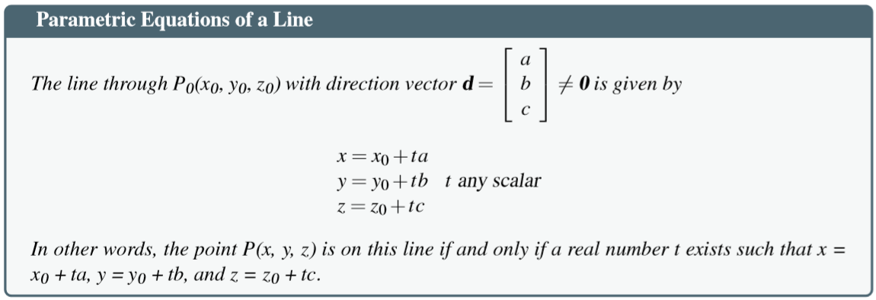






Lines in Space

Slide 16
Lines in Space
Ex. Given P₀()

Slide 17
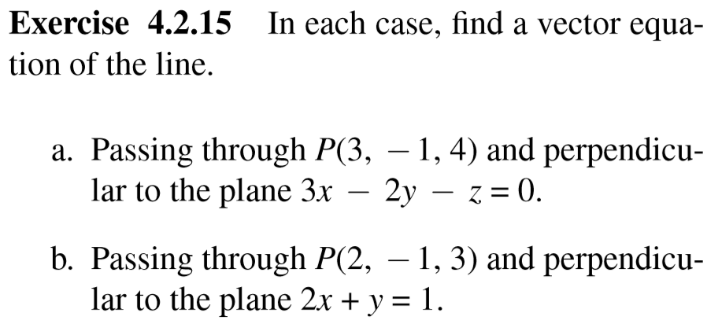









Slide 18
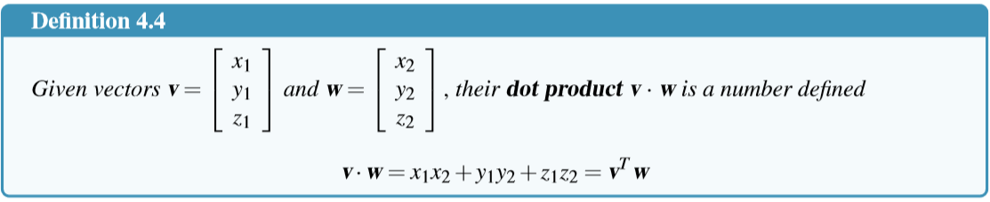


4.2 Projections and Planes
The Dot Product

Slide 19
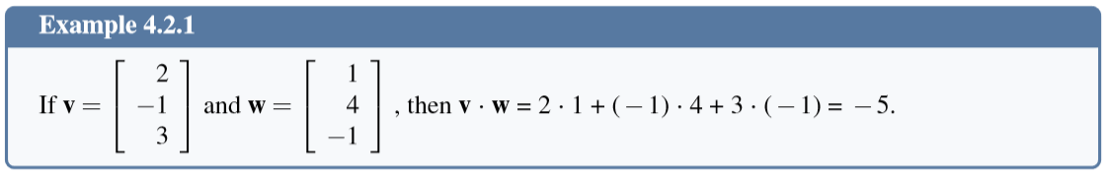


The Dot Product

Slide 20
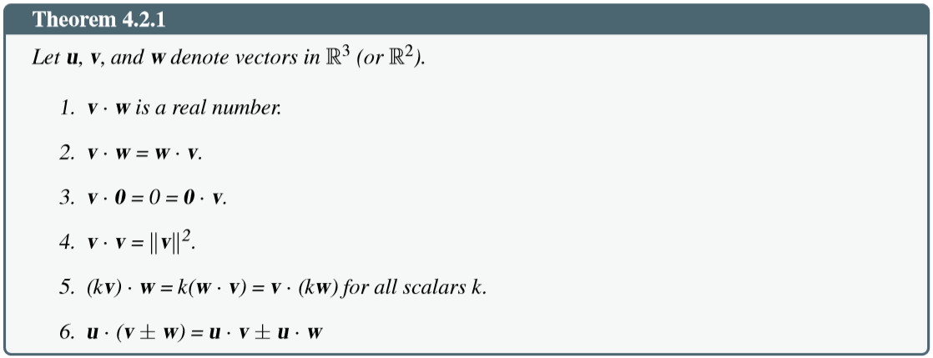
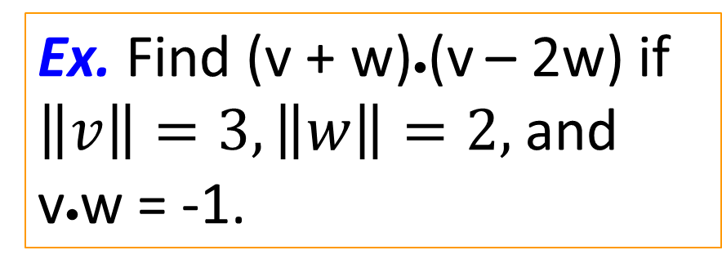
Properties of dot product
Ex. Find (v + w)•(v – 2w) if $\left\|v\right\|=3, \left\|w\right\|=2,$and v•w = -1.

Slide 21
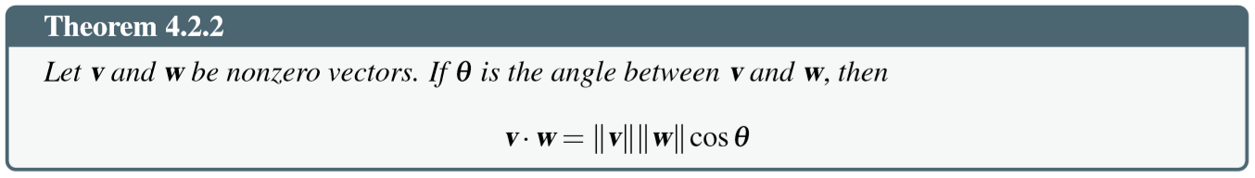
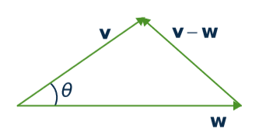
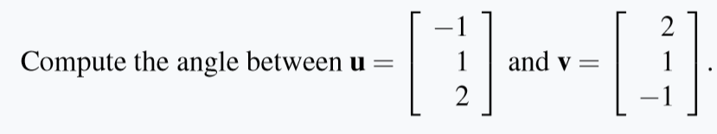






Angles between vectors
Example.

Slide 22
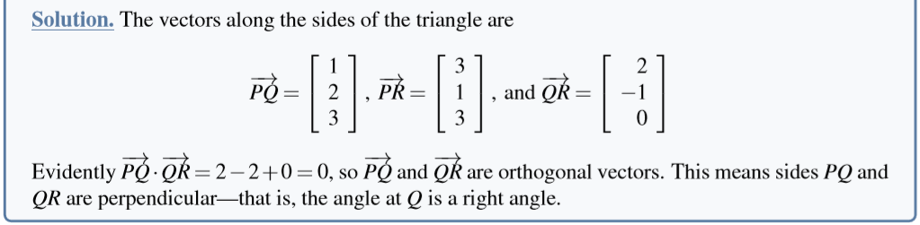



Orthogonality
Two vectors v and w are said to be orthogonal if and only if
v • w = 0

Slide 23
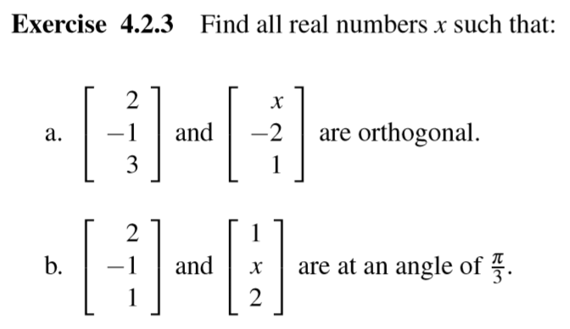

Slide 24
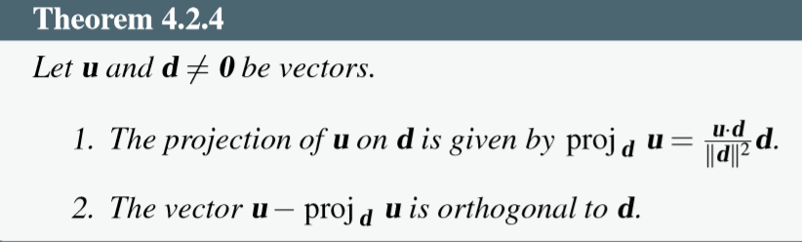






Projection
u
u – v
1. v ⁄ d
2. u – v ⊥ d
•
d
v

Slide 25
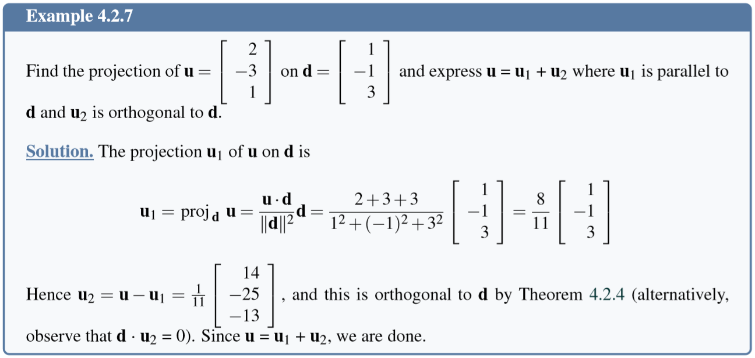








Projection

Slide 26
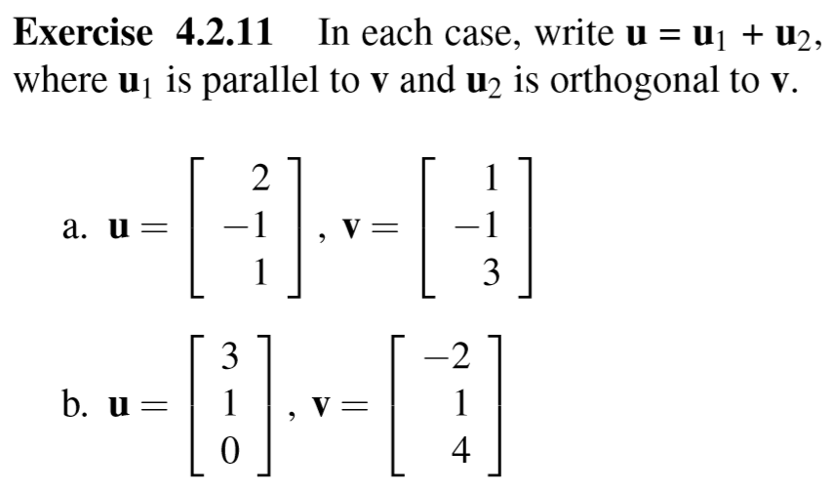


Slide 27
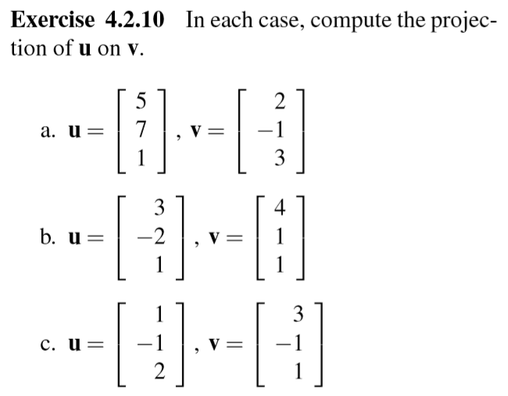

Slide 28
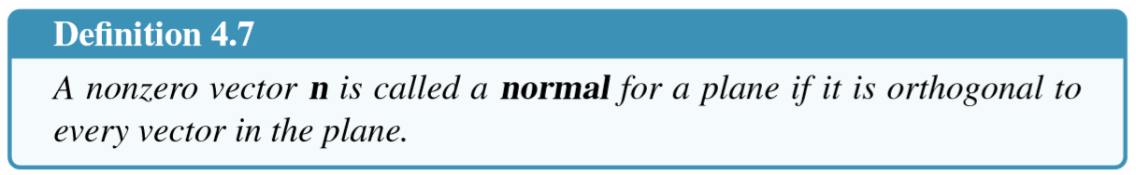
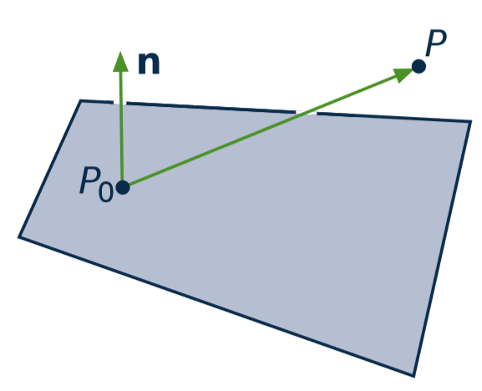
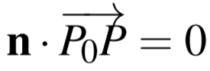
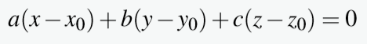
Planes

Slide 29
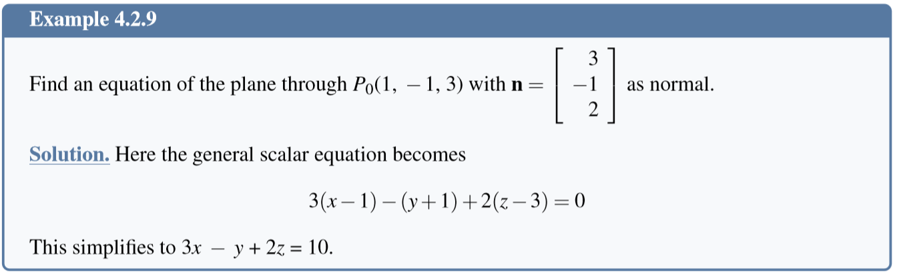
Equation of a Plane

Slide 30
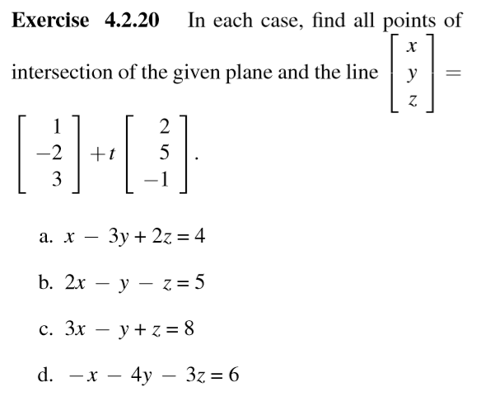
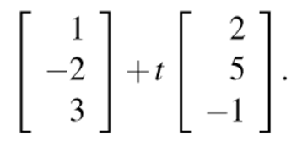

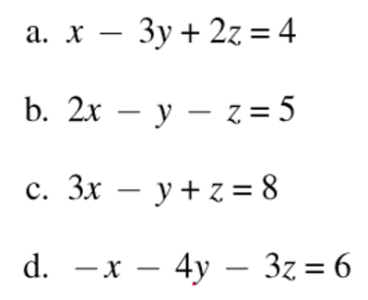









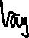





Slide 31











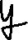

Slide 32
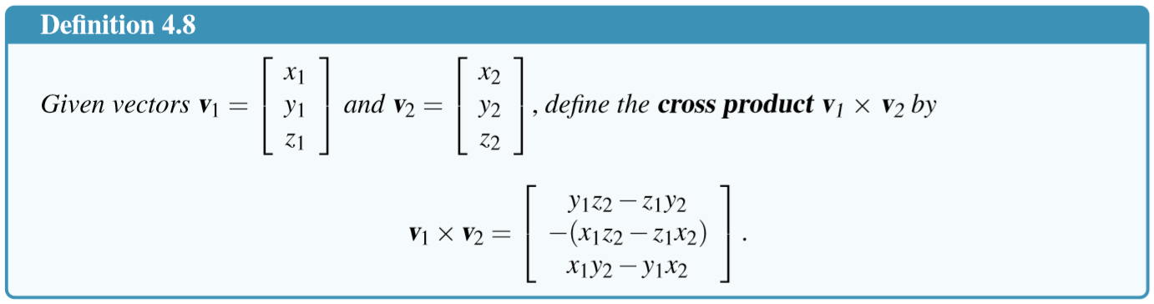

The Cross Product

Slide 33
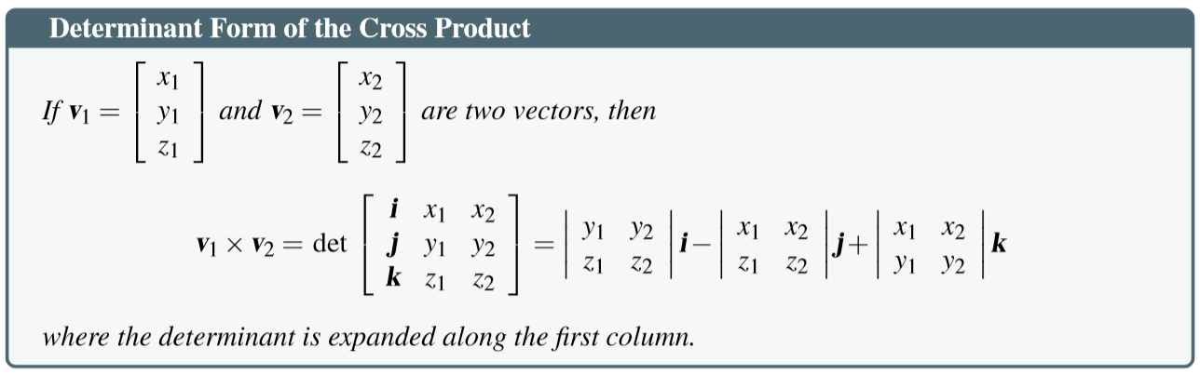





Slide 34
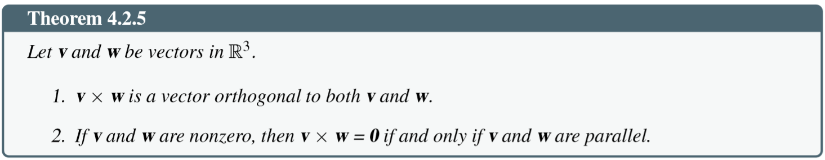



Properties of cross product

Slide 35
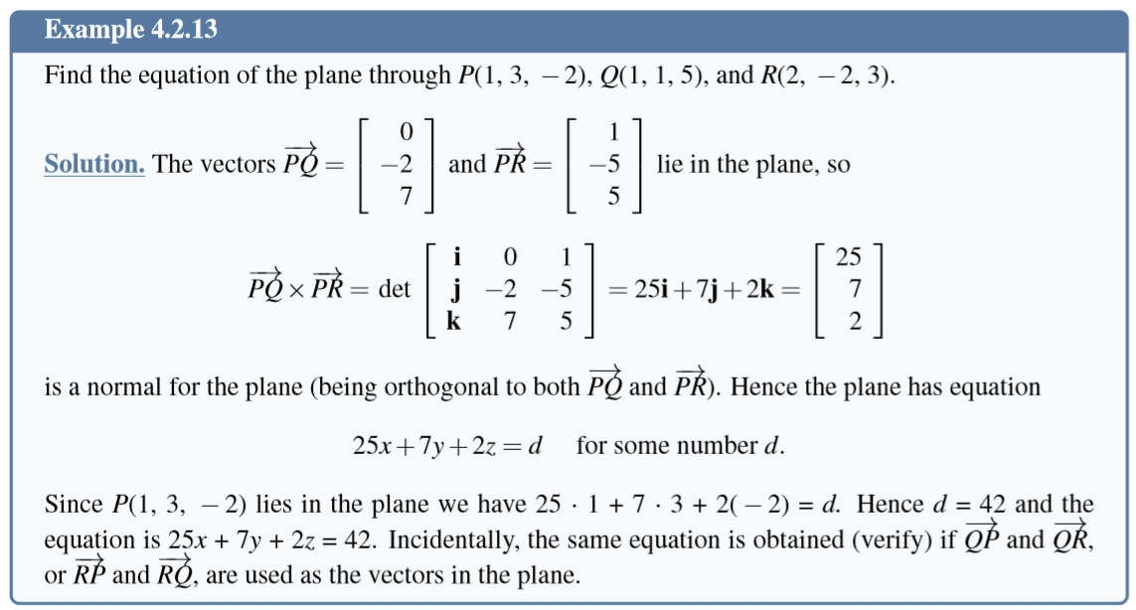

Slide 36
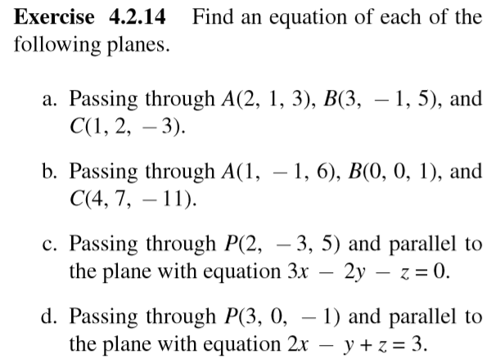
Exercises – equations of planes

Slide 37
4.3 More on Cross Product
Read yourself pages

Slide 38
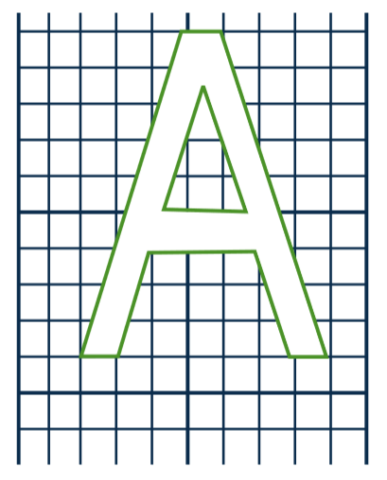
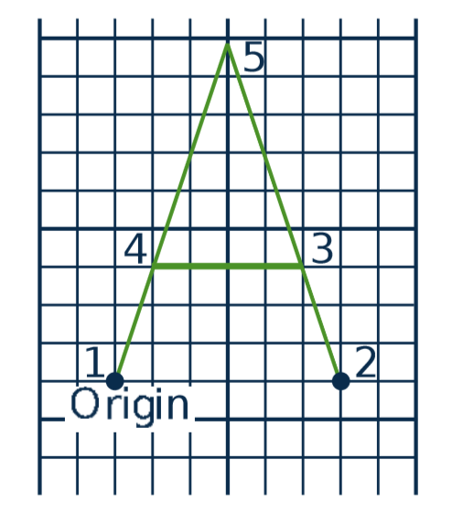
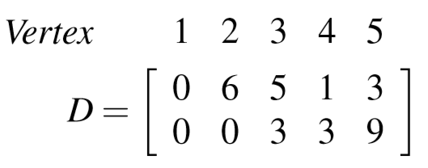
4.5 An application in Computer Graphics
Data matrix D

Slide 39
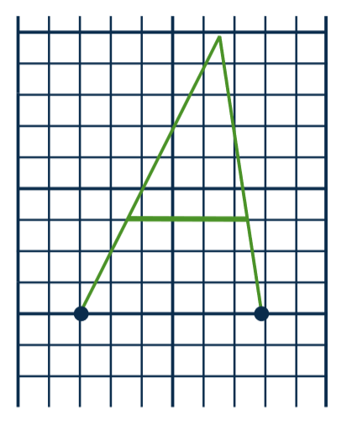
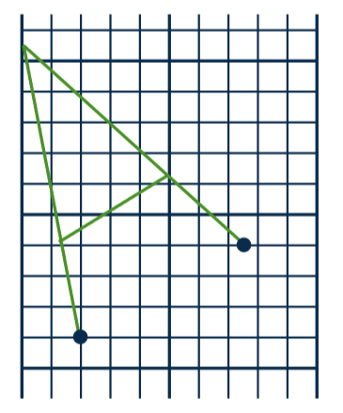
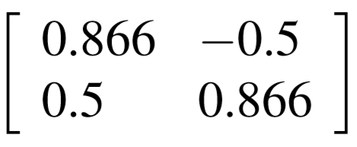
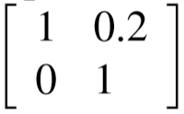
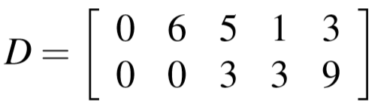


How to change image?
C
D
C

Slide 40
Computer graphics
Image ➔ matrix D
Matrices of transformations A₁, A₂, ..., A_{n}
Compute A_{n}...A₃A₂A₁D
3rd transformation
1st transformation
Data matrix
n^{th} transformation
2nd transformation

Slide 41
Some common transformations and their matrices
Reﬂections and Projections
Rotations
Translations

Slide 42






Matrices of Reﬂections and Projections
Reﬂections and Projections

Slide 43

Matrices of Rotations

Slide 44
Matrices of Translations
Need a clever way to give these matrices (Read yourself in the text book)

Slide 45
Summary
4.1. Vectors and Lines
4.2. Projections and Planes
4.3. More on the Cross Product
4.4. Linear Operations on ○³
4.5. An application to Computer Graphics

